Slide 1
Project:
MealMate
Subject: CS691
Computer Science
Project 1

Slide 2
Agenda
The Objective of this meeting is to give an overview of the Project
Introduce the team members and what are their roles and responsibilities
What is the project design
Brief overview of the technologies we proposed to use in the project
Interaction, attendance, co-operation, team work, attention from each team member is needed to make the project success.

Slide 3
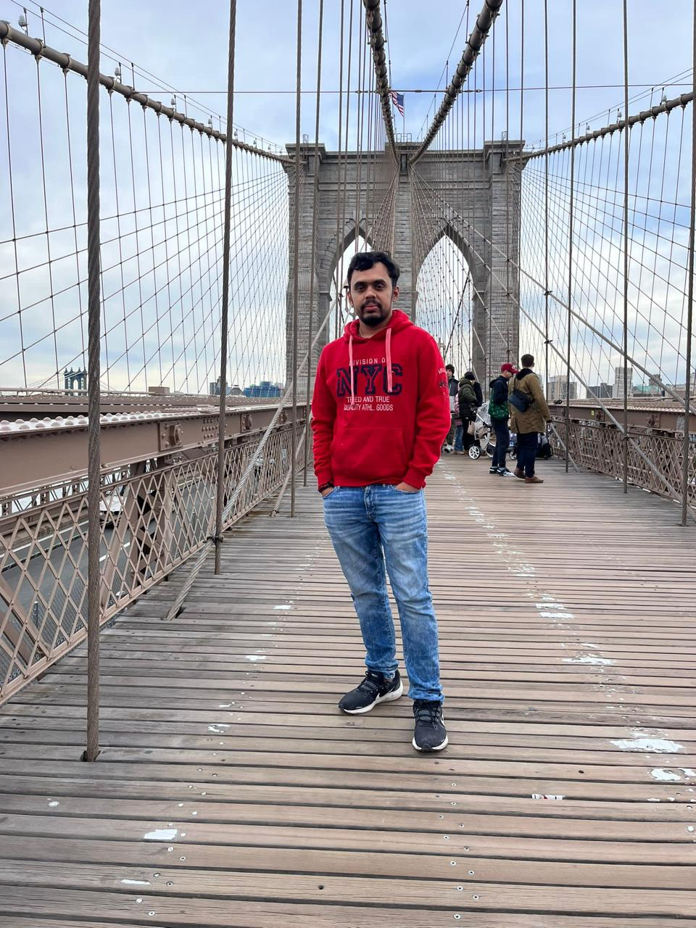
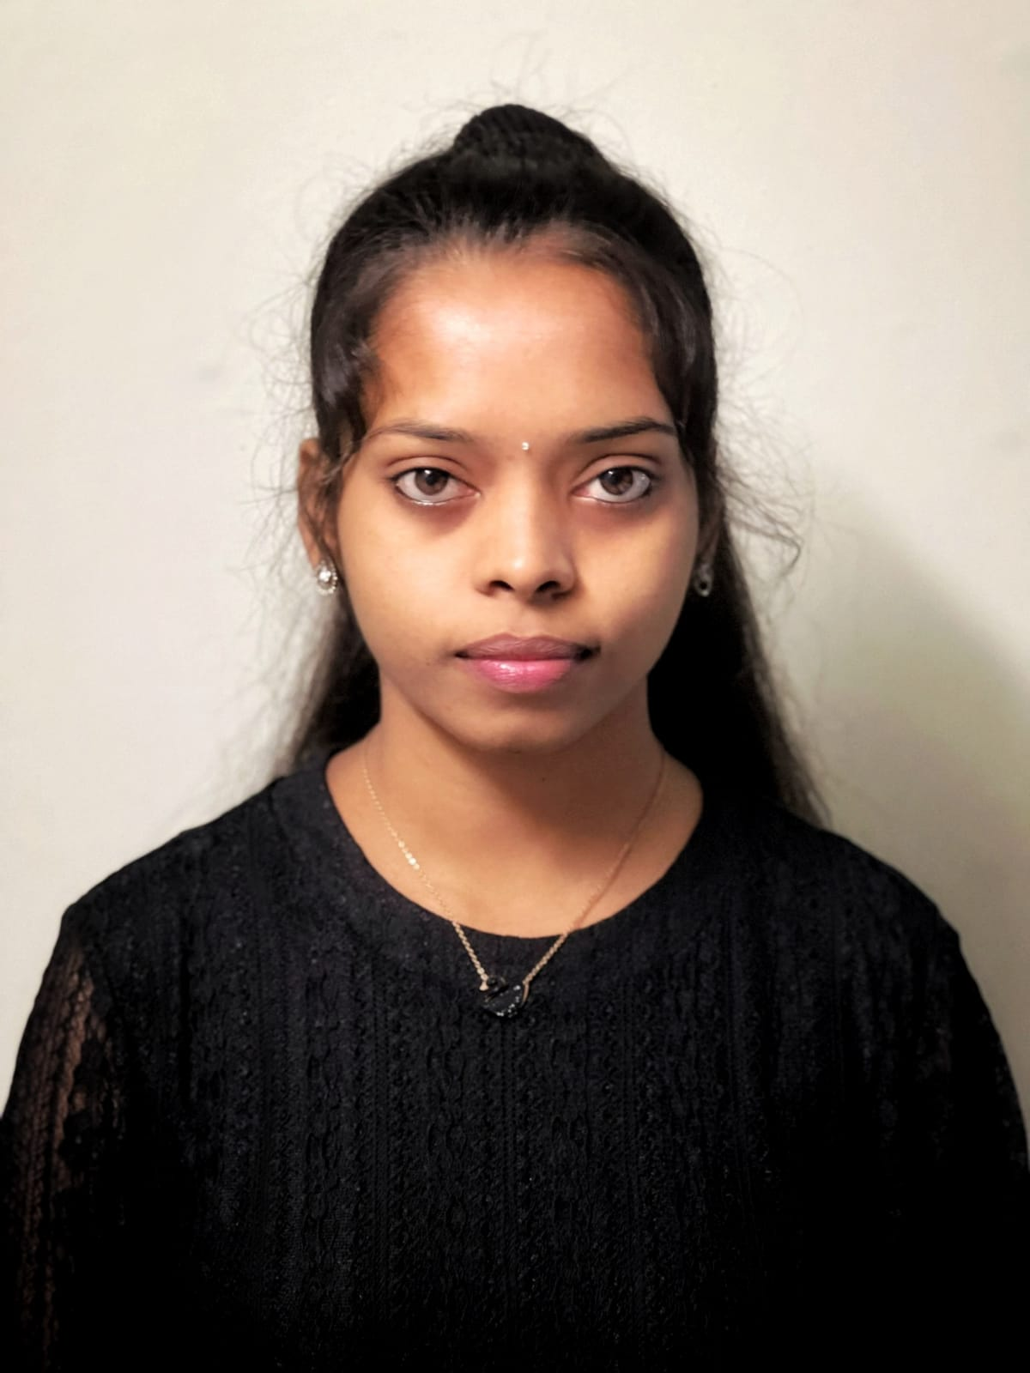

Team Members Roles
Sarath Upadrista
Business Analyst & Developer
Archana
Project Manager
Quality Analyst & Tester
Dharavath, Harika
Database Administrator

Slide 4
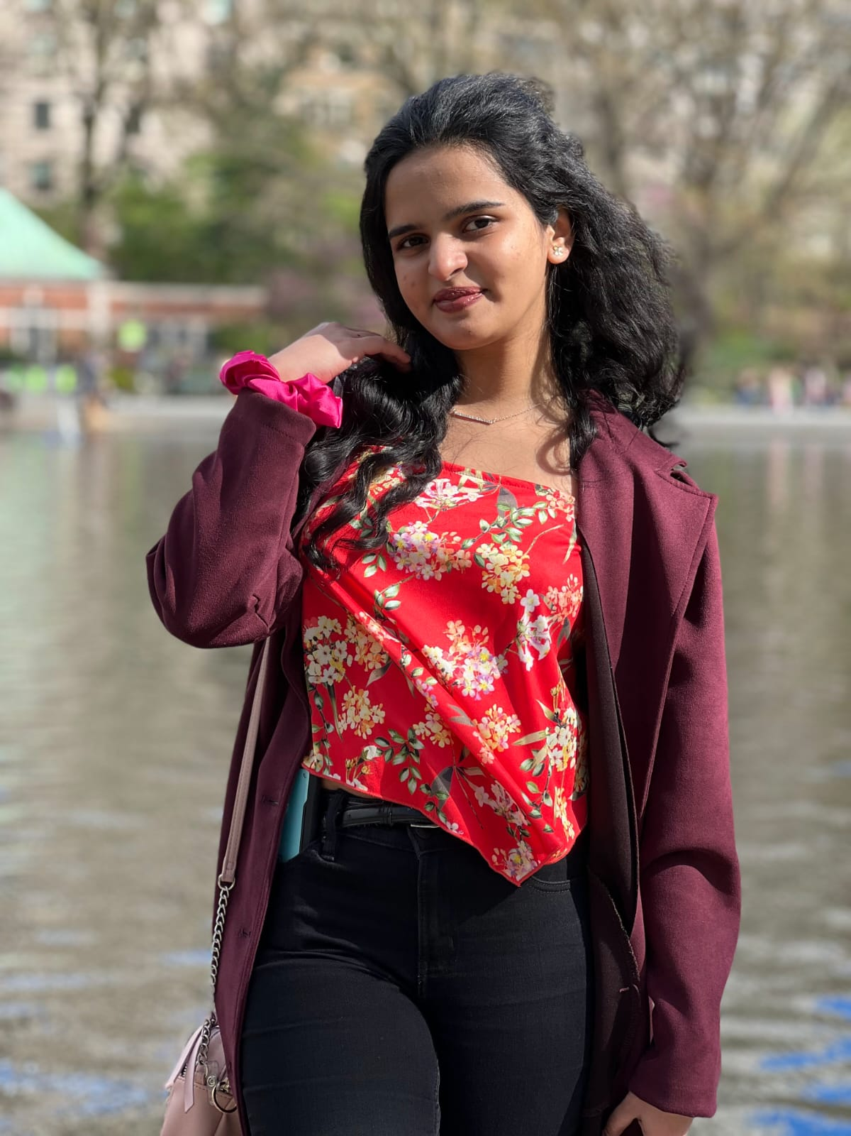
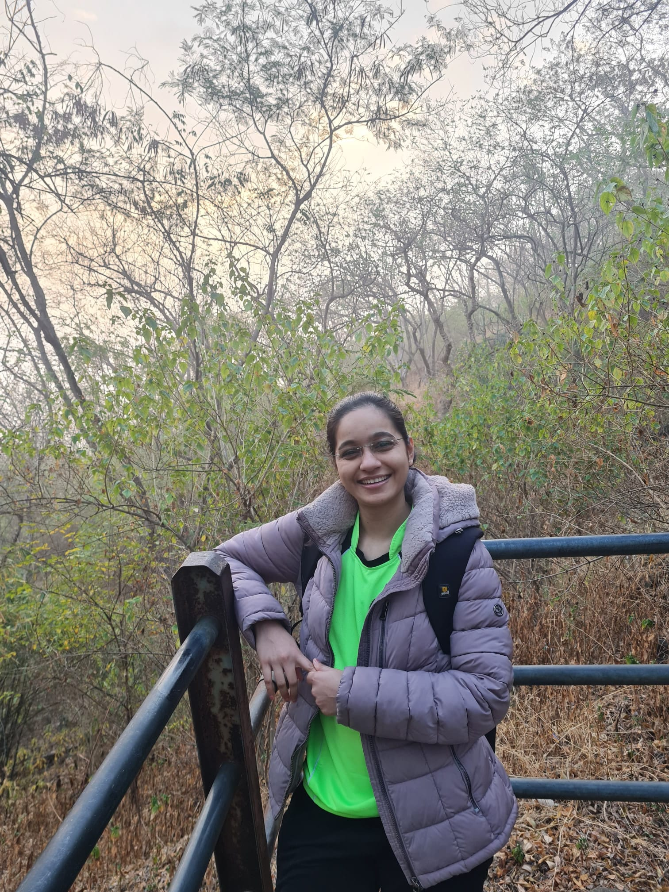
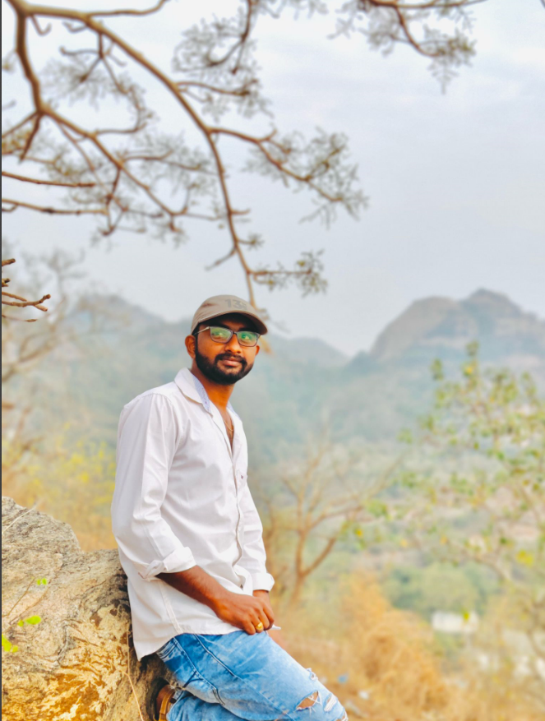
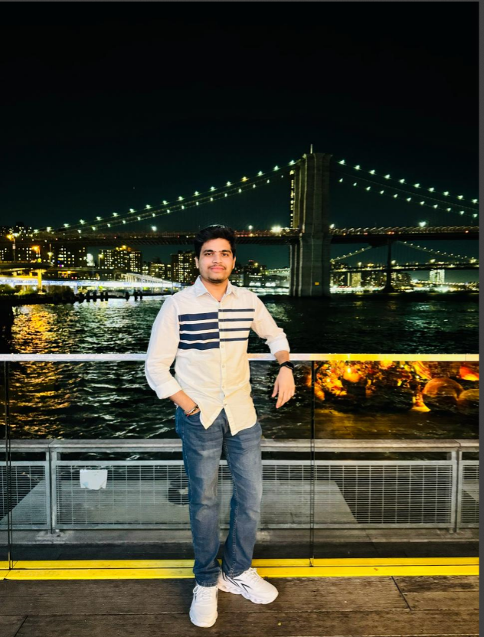
Team Members Roles
Pavan
Developer
Avhad, Dipali Vijay
Developer
Kundan
Developer

Slide 5

Problem statement

Slide 6
Problem Statement
In contemporary times, individuals residing independently or within family units frequently encounter the quandary of meal planning. The task of determining what to cook becomes burdensome, particularly when considering the variety of vegetables available at home. This challenge is compounded by the need to carefully assess the inventory of vegetables before deciding on a recipe. As a result, the process of meal preparation often involves significant time and effort.

Slide 7

project Description

Slide 8
Project Description
The “MealMate" web application aims to revolutionize meal planning by leveraging cutting-edge technology. Through the utilization of image processing algorithms, the application will transform the way individuals approach cooking. By simply uploading images of vegetables, users will receive personalized recipe recommendations tailored to their available ingredients. This innovative approach promises to simplify the meal preparation process and alleviate the burden of decision-making, ultimately enhancing the culinary experience for users.

Slide 9
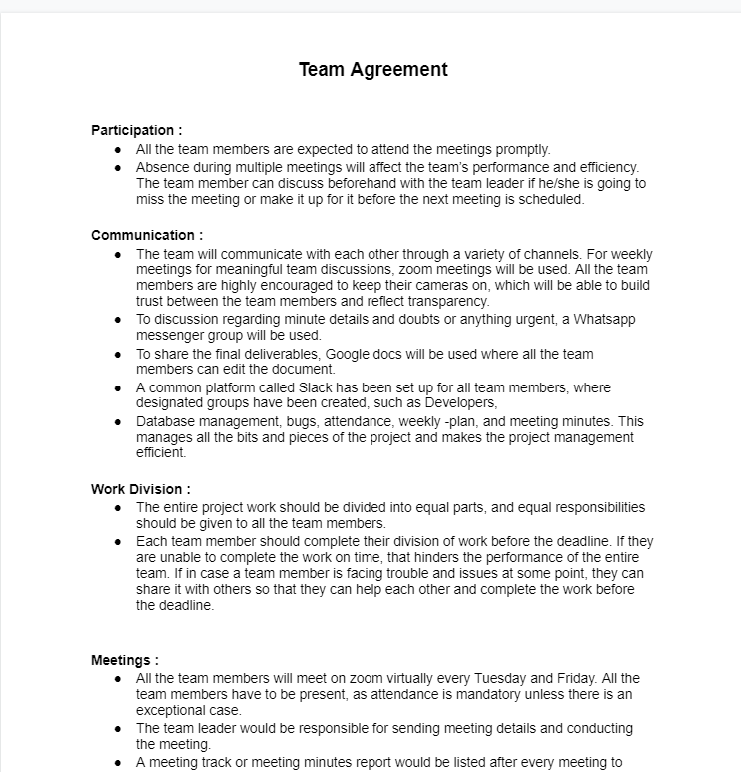
Team Working Agreement
Agreement - Google Docs

Slide 10
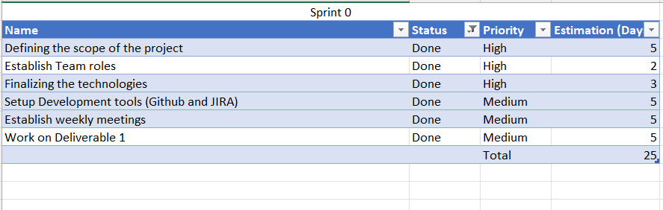
Sprint 0 Completed Tasks

Slide 11

Retrospective

Slide 12
What helped us move forward
Due to communication, we were able to understand the objective well.
Teamwork helped in requirement gathering.
We have listed down the technologies which will be used. Although we still need to learn the concepts in depth to be able to make a good product.

Slide 13
What held us back
Meeting schedules have to be planned carefully.
Team participation requires a slight improvement.

Slide 14
What should we do next
Proper availability of time needs to be discussed.
Get a clear idea of deadlines to finish the tasks as per schedule.
Start working on the activities assigned.

Slide 15
How could we do things differently
We need to use slack workspace more than Whatsapp group chat. So that we can get exposure to how things are been organize in-office conversations and correct applications they use daily.
Helping and motivating each other as a team if some or other in a group lacks some skills/ give them space to learn.

Slide 16
Wiki page Link
https://github.com/upadristasarath/CS691_CapstoneProject_MealMate

Slide 17
Thank you

